Slide 1

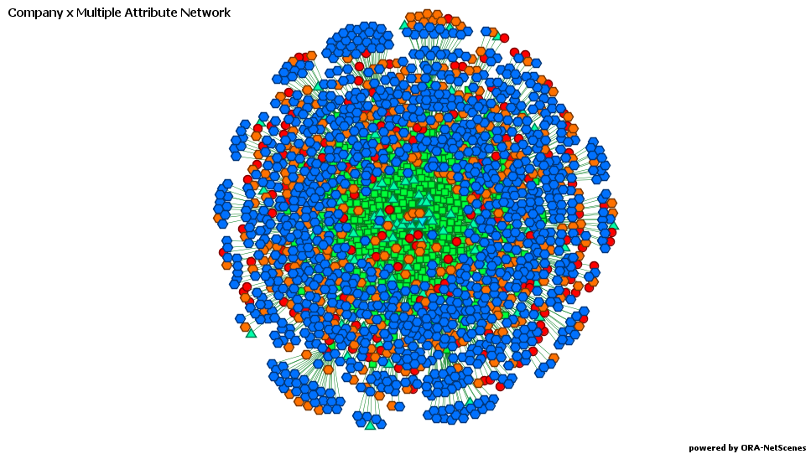
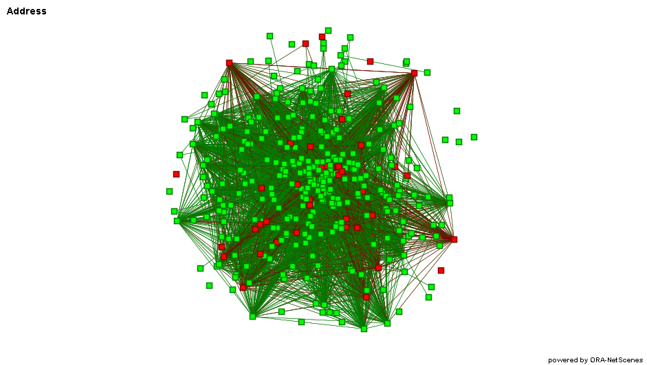
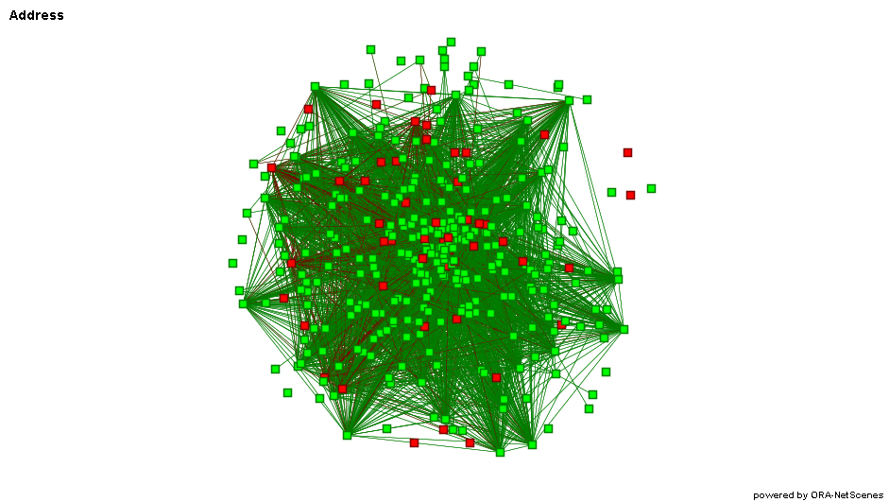
Mismanaged Minerals– A Network Analysis of Uganda’s Mining Sector
Bridget Connelly
Math 442 Mathematics of Social Networks, Georgetown University, Washington, D.C.
Abstract
Results
Uganda borders several countries known for using conflict minerals to finance violence and terrorism. Because of this, a recent boom in Uganda mining has been accompanied by allegations of corruption, collusion, and smuggling. Recent news reports highlighted specific companies and their ties to either potentially corrupt Ugandan officials or regional unrest. As a network of organizations with varying degrees of connection to the governing bodies of Uganda, however, the mining sector has not been well examined. A network analysis examines the relationships among allegedly corrupt and their impact on the rest of the mining industry in Uganda.
Company x Attribute Network
Because of high correlation, only the “Contact Name” and “PO Box” attributes were examined. Degree centrality analysis uncovered several key attributes that heavily contributed to the density of the network. Expecting the network to be relatively sparse, these high degree attributes were anomalies and warranted further investigation. Of the “Contact Name” attributes, 3 of the top 7 were associated with corrupt companies. A Louvain community detection algorithm also identified subgroups of highly connected corrupt companies. In one group with 11 members, 6 were corrupt.
Fig. 1. Company x Multiple Attributes network. Companies are represented as green squares, and their attributes, “concession number,” “address,” “contact name,” “mineral,” and “district” are represented in the other colors. Centrality analysis identified several attributes of corrupt companies that play important roles in the network.
Company x Company Network
The effect of the corrupt companies on the folded networks was examined by comparing the effects of removing the corrupt companies against the effects of removing a different, similarly sized subgroup. This group was the “companies” that were in fact individual people holding a mining concession. There were 46 corrupt companies and 51 “individual”-companies. There difference in removing these sets of subgroups in the company x address x company network is small. The density decreases slightly in both cases. By contrast, in the company x mineral x company network the difference is stark – density increases after removal of “individual”-companies and decreases with removal of corrupt companies.
A
B
Introduction
The Ugandan mining sector has received international scrutiny because of a recent boom in gold mining and the country’s proximity to regions known for criminals using profits from mineral enterprises to finance violence and corruption. Recent reports about the industry examined the existing corruption in the industry by highlighting several companies alleged to use money or political power to gain access to Ugandan mining sites. A network approach to analysis draws out the ties that exist in the Ugandan mining sector – both the ties that companies have with specific attributes like contact names, addresses, or specific minerals, and between the companies themselves as a result of sharing these attributes. Analysis of these ties uncovers the attributes that are most tied to corruption, and the influence that corruption has on the overall network.
Fig. 1(A-B). Comparing the effects of subgroups on the company x address x company network. Regular company nodes in green and subgroup company nodes in red. A) The corrupt nodes are colored in red. Removing them plays a more significant role in decreasing overall density. B) The individual nodes are colored in red. There are more individual-based isolates.
Discussion and Limitations
Conclusions
Data Limitations
The data was limited in two main respects. The Uganda Ministry of Energy and Mineral Development had different reporting requirements over the years, resulting in companies with few or no attributes. No missing links were inferred, meaning that the lack of a tie could mean that there is no tie or there is no data. Additionally, and as a result of the inherently illicit nature of corruption, it is likely that the companies in the Global Witness report do not encompass the entirety of corrupt companies operating in Uganda. Here, too, lack of accurate data, especially in such a sparsely connected network, could skew results.
Network analysis of the mining sector in Uganda identifies key individuals and companies that appear to be linked to corruption. However, the impact of these corrupt companies on the overall structure of the network is unclear when compared with the effect of similar subgroups.
Data Collection
Data regarding the mining companies in Uganda was gathered from the annual Statistical Abstracts that the Uganda Ministry of Energy and Development releases available online from 2011- 2015.^{1,2,3,4,5} Information on whether these companies have been accused of corruption was gathered from the companies named in the Global Witness report “Undermined,” released in July 2017.³ After cleaning and initial analysis, this resulted in a set of 372 companies, with 46 of these considered “corrupt.”
References
Discussion
This analysis was an initial review of the Ugandan mining industry, and the effects that corruption could play on it. Further research could compare the attribute and folded networks against stylized networks, include a greater variety of data (e.g. director information for companies), or compare the Ugandan network against the mining network of a similar country without corruption issues.
Ministry of Energy and Mineral Development. "2011 Statistical Abstract." Statistical Abstract. n.d. <http://barakaconsult.com/uploads/2011StatisticalAbstract.pdf>.
—. "2012 Statistical Abstract." Statistical Abstract. n.d. <http://barakaconsult.com/uploads/2012%20StatisticalAbstract.pdf>.
—. "2013 Statistical Abstract." Statistical Abstract. n.d. <http://www.energyandminerals.go.ug/downloads/2013StatisticalAbstract.pdf>.
—. "2014 Statistical Abstract." Statistical Abstract. n.d. <http://www.energyandminerals.go.ug/downloads/2014StatisticalAbstract.pdf>.
—. "2015 Statistical Abstract." Statistical Abstract. n.d. <http://www.energyandminerals.go.ug/downloads/2015%20Statistical%20abstract.pdf>.
Global Witness. "UnderMined." Investigative Journalism. 2017.

